Slide 1
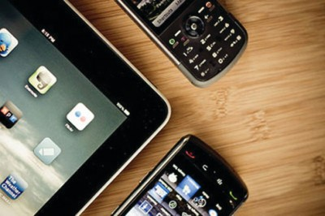
BYOD-Bring Your Own Device
Nickajack Elementary School
Target Grades 4-5

Slide 2
What Does It All Mean?
http://www.youtube.com/watch?feature=player_detailpage&v=YmwwrGV_aiE

Slide 3
Today’s Students Are:
digital natives
live in a multimedia world
only know media in all color
prioritize visual learning
demand creativity
learn best through trial and error
constantly connect and collaborate
access information that is live and linked

Slide 4
Why BYOD?
We want:
To leverage technology to create relevant learning experiences for students that mirror daily lives.
Students to power-up when they come to school.
Students to have access to information/digital resources for instruction 24/7.
To supplement what we already have in terms of technology and access to information/resources.
Focus on instruction…not the tool.

Slide 5
Why Now?
BYOD gives our students the opportunity to:
Have immediate access to information and on-line academic resources
Use devices they are familiar with and comfortable using
Take advantage of state-of-the-art applications for learning
Participate in more student-centered learning
Engage in more one-on-one interaction

Slide 6
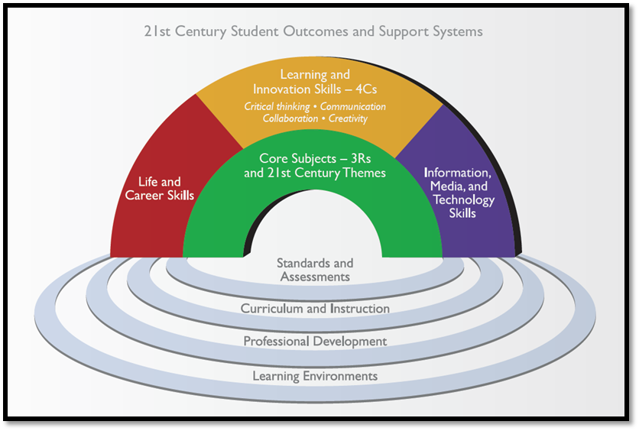
Why Change?
Constant change requires independent learners with new skills for changing work environments: critical thinking, collaboration, creativity, and communication.

Slide 7
What Are Our Goals?
Promote higher order thinking, creativity and other 21st Century Skills
Increase student engagement
Promote greater collaboration (between teachers/students/parents) using Web 2.0 tools
Increase student access to technology/digital resources
Integrate technology seamlessly into curriculum
Increase project-based learning activities
Model good digital citizenship and professionalism

Slide 8
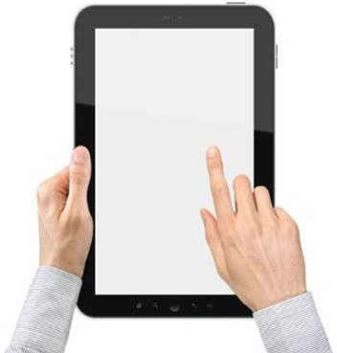
Supporting Target Standards
Critical Thinking and Problem Solving
Collaboration
Agility and Adaptability
Initiative and Entrepreneurialism
Effective Oral and Written Communication
Accessing and Analyzing Information
Curiosity and Imagination

Slide 9
Teaching New Literacies
Overlapping, but distinctive:
Digital
Media
Global

Slide 10
What You Need To Know
Definition of “Device”
Network Connectivity
Security and Damages
BYOD Student Agreement
Classroom Regulations and Expectations

Slide 11
Devices May Include
Laptops
Netbooks
Tablets
eReaders
iPod Touch
Smart Phones

Slide 12
Connectivity
Only the CCSDBYOD Wi-Fi network will be used.
This connection has the same filters students use with school-owned technology.
3G or 4G networks will not be accessed during the school day.

Slide 13
Security
Students are responsible for the security and operation of their own devices.
Students will:
Password protect their device
Make device easily identifiable (skins/stickers) Record the serial number of their device
Use only their own device
Have their device in their desk, backpack, or carry it with them at all times

Slide 14
Security
The school district is not liable for stolen or damaged devices.
Stolen or damaged devices will be handled similar to other personal artifacts.
Target classroom will be locked during specials and lunch or any other time teachers are not in the room.
Students may not bring devices on non-Target days.

Slide 15
BYOD Student Agreement
Student agreement located at the end of the parent letter.
CCSD Student Code of Conduct
Acceptable Use Policy
Classroom consequences will be as outlined on parent letter.
Sticker must be applied to agenda, after receipt of signed parent letter and student agreement.

Slide 16
Frequently Asked Questions
Parent Letters have been provided and FAQs are attached for your information.
If you have a question pertaining to you or your child, specifically, please email us.

Slide 17
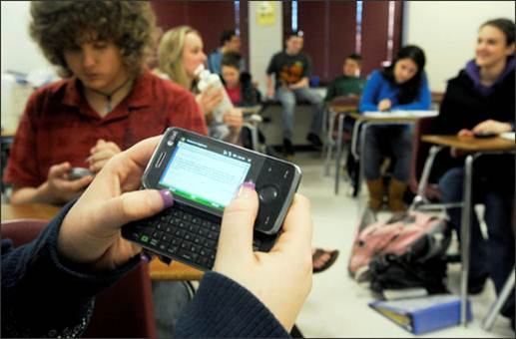
Classroom Regulations & Expectations

Slide 18
When Will Devices Be Used?
For instructional purposes only:
In the classroom setting
Under teacher direction
Not for calls or social texting
Students should come prepared with their device fully charged every Target day

Slide 19
Students Will:
Keep phones and other devices off until Target day begins.
NOT record audio or video, or take photographs of students or staff for any reason whatsoever without express consent from the teacher and individuals to be recorded.
Comply with teacher requests to shut down their devices or close screens.
Keep all devices in the Target classroom, unless indicated otherwise by teachers.

Slide 20
Acknowledgements
Some content and photos were used from the CCSD BYOD PowerPoint, Varner Elementary BYOD PowerPoint and Lovinggood BYOD PowerPoint

